Slide 1
Week 4th
Prepared by Dr Syed Khaldoon Khurshid

Slide 2
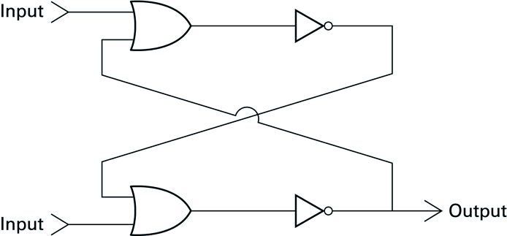
Another way of constructing Flip-Flop
Assignment: Write outputs & sequence of steps on the basis of following inputs?
upper input = 1 and lower input = 0
upper input = 0 and lower input = 0

Slide 3
Solution:
1
0
1
1
0
0
1
1
0

Slide 4
Solution:
1
0
0
1
0
0
1
1
0

Slide 5
1.4 Representing Information as Bit Patterns
Now that we know how to store single bits, we can consider how information can be encoded as bit patterns
Different encoding systems exist for different types of information
numbers, text, images, sound, …
Encoding systems more and more standardized
American National Standards Institute (ANSI)
International Organization for Standardization (ISO)

Slide 6
1.4 Representing Text
Each symbol represented by a unique bit pattern
Text represented by long stream of patterns
Today’s standard coding system:
ASCII (American Standard Code for Information Interchange)
Bit patterns of length 7 (generally extended by 1 bit)
See ASCII-table in Appendix A.

Slide 7
ASCII
ASCII stands for American Standard Code for Information Interchange. Computers can only understand numbers, so an ASCII code is the numerical representation of a character such as 'a' or '@' or an action of some sort. ASCII was developed a long time ago and now the non-printing characters are rarely used for their original purpose. Below is the ASCII character table and this includes descriptions of the first 32 non-printing characters.

Slide 8
ASCII
ASCII was actually designed for use with teletypes and so the descriptions are somewhat obscure. If someone says they want your CV however in ASCII format, all this means is they want 'plain' text with no formatting such as tabs, bold or underscoring - the raw format that any computer can understand. This is usually so they can easily import the file into their own applications without issues. Notepad.exe creates ASCII text, or in MS Word you can save a file as 'text only

Slide 9
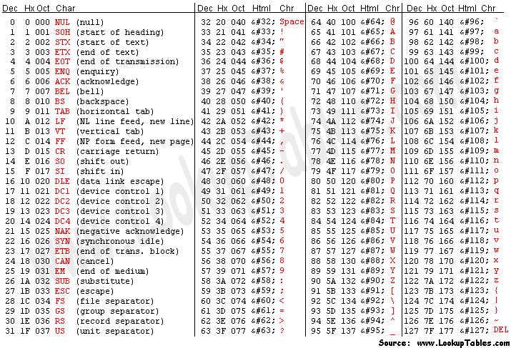

Slide 10
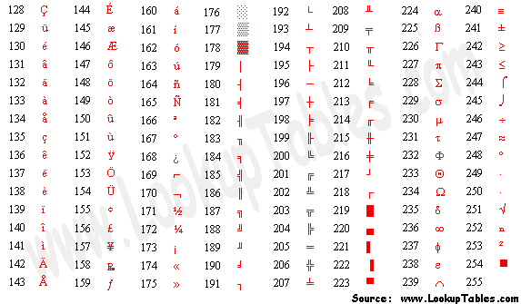
Extended ASCII Codes

Slide 11
1.4 Representing Numbers
ASCII-encoding inefficient for numeric values
Consider storing the value 25:
In ASCII: 00110010 00110101 (16 bits)
Worse: largest 16-bit number would be 99
More efficient approach is to use binary system
uses digits 0 and 1, incl. factor 2 for all bit-positions
Compare decimal system
uses digits 0, 1, 2, 3, 4, 5, 6, 7, 8, and 9, incl. factor 10 for each decimal position

Slide 12
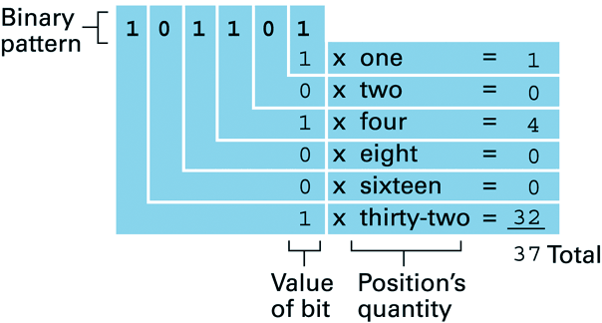
1.4 Decoding the Binary Representation 100101
0
1×2⁵ + 0×2⁴ + 0×2³ + 1×2² + 0×2¹ + 1×2⁰ = 37

Slide 13
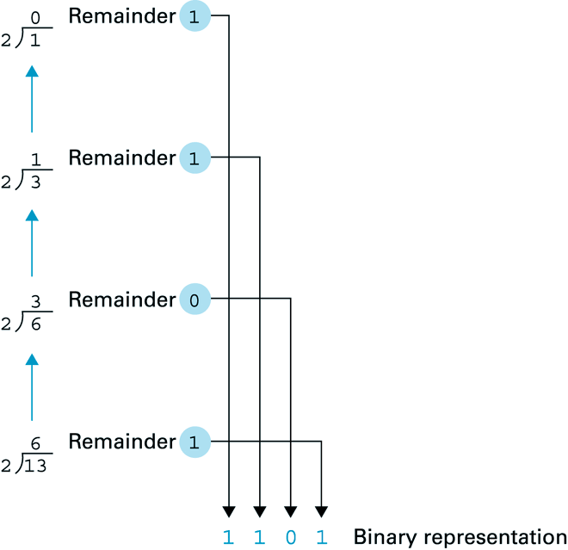
1.4 Obtaining the binary representation of 13

Slide 14

1.5 The Binary System: Addition
Knowing how numeric values are encoded, we can consider how to do calculations
Binary addition:
Example:
0 0 1 1 1 0 1 0
+ 0 0 0 1 1 0 1 1
(58 + 27 = 85)
0
1
0
1
0
1
0
1

Slide 15
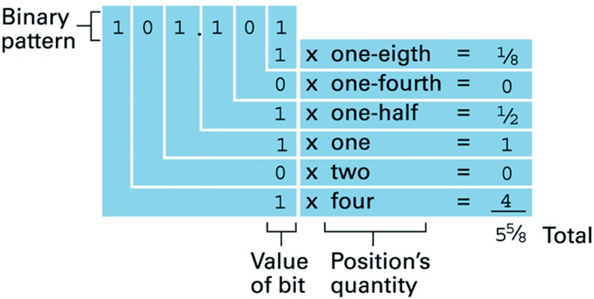
1.5 Fractions in the Binary System
Radix point has same role as in decimal system

Slide 16
Fraction Decimal to Fraction Binary Conversion Convert .625 into Binary:

Slide 17
Fraction Decimal to Fraction Binary Conversion: Convert .625 into Binary:
In fact, there is a simple, step-by-step method for computing the binary expansion on the right-hand side of the point. We will illustrate the method by converting the decimal value .625 to a binary representation..
Step 1: Begin with the decimal fraction and multiply by 2. The whole number part of the result is the first binary digit to the right of the point.
Because .625 x 2 = 1.25, the first binary digit to the right of the point is a 1.
So far, we have .625 = .1??? . . .
Ref: http://cs.furman.edu/digitaldomain/more/ch6/dec_frac_to_bin.htm

Slide 18
Fraction Decimal to Fraction Binary Conversion: Convert .625 into Binary:
Step 2: Next we disregard the whole number part of the previous result (the 1 in this case) and multiply by 2 once again. The whole number part of this new result is the second binary digit to the right of the point. We will continue this process until we get a zero as our decimal part or until we recognize an infinite repeating pattern.
Because .25 x 2 = 0.50, the second binary digit to the right of the point is a 0.
So far, we have .625 = .10?? . . .
Ref: http://cs.furman.edu/digitaldomain/more/ch6/dec_frac_to_bin.htm

Slide 19
Fraction Decimal to Fraction Binary Conversion: Convert .625 into Binary:
Step 3: Disregarding the whole number part of the previous result (this result was .50 so there actually is no whole number part to disregard in this case), we multiply by 2 once again. The whole number part of the result is now the next binary digit to the right of the point.
Because .50 x 2 = 1.00, the third binary digit to the right of the point is a 1. So now we have .625 = .101?? . . .
Step 4: In fact, we do not need a Step 4. We are finished in Step 3, because we had 0 as the fractional part of our result there.
Hence the representation of .625 = .101
Ref: http://cs.furman.edu/digitaldomain/more/ch6/dec_frac_to_bin.htm

Slide 20
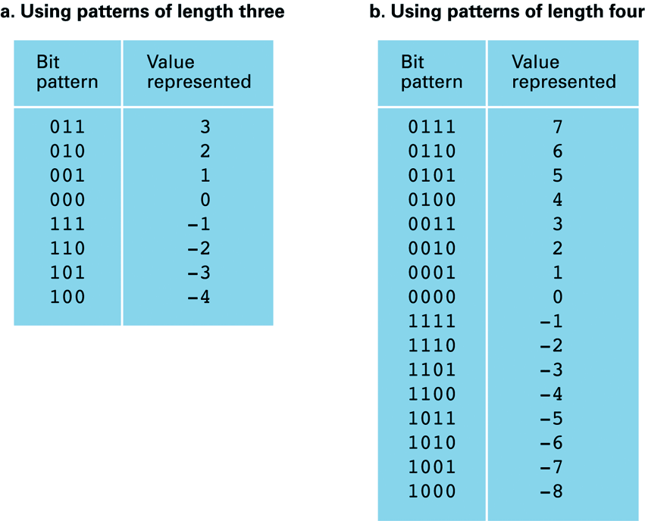
1.6 Storing Integers: Two’s Complement Notation
In general: values of 32 bits
Includes negative numbers
Leftmost bit indicates the sign
sign bit
Note:
Positive and negative numbers are identical from right to left up to & including first ‘1’; from there on are complements of one another

Slide 21
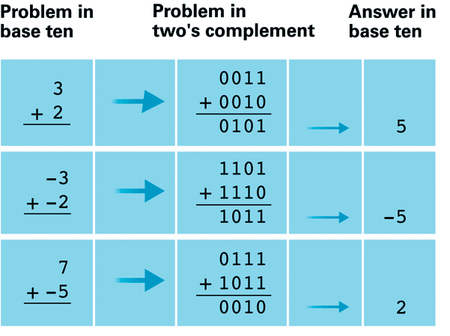
1.6 Addition in two’s complement notation
Note: no circuitry for subtraction needed!
Note: overflow errors: 0101 + 0100 = 1001 (5 + 4 = -7)

Slide 22
Chapter 1: Problem 23 Here's a message in ASCII. What does it say? 01010111 01101000 01100001 01110100 00100000 01100100 01101111 01100101 01110011 00100000 01101001 01110100 00100000 01110011 00110001 01111001 00111111
Each block of 8 bits represents one character:
See ASCII table in Appendix A
Example: 01010111 = ‘W’
Message says: ‘What does it s1y?’
Note: 00110001 = ‘1’, while 01100001 = ‘a’…

Slide 23
Chapter 1: Problem 28 a. Write the number 14 by representing the 1 and 4 in ASCII. b. Write the number 14 in binary representation.
a. See ASCII Table in Appendix A:
14 = 00110001 00110100
b. In binary system each ‘1’ represents a power of 2:
14 = 8 + 4 + 2 = 1×2³ + 1×2² + 1×2¹ + 0×2⁰ => binary: 1110

Slide 24
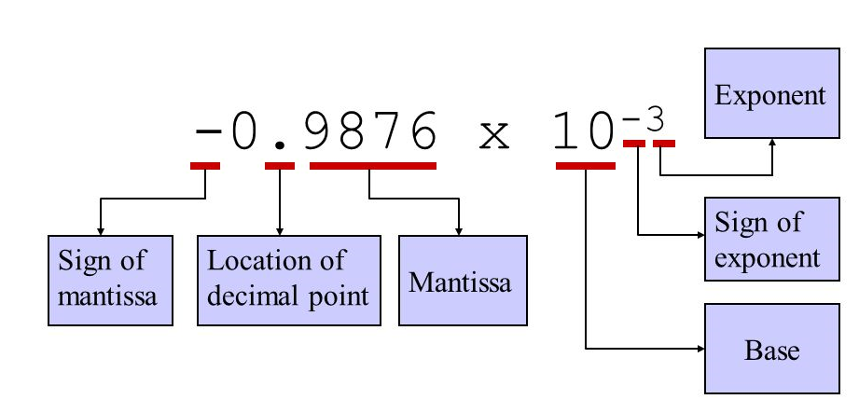
Parts of Floating-point Notation

Slide 25
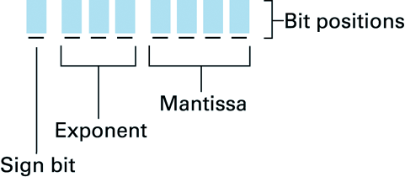
1.7 Storing Fractions: Floating-point Notation
In contrast to integers, fractions require storage of the radix point
Floating-point notation
Example: 1 110 1011 = -10.11 = -2.75

Slide 26
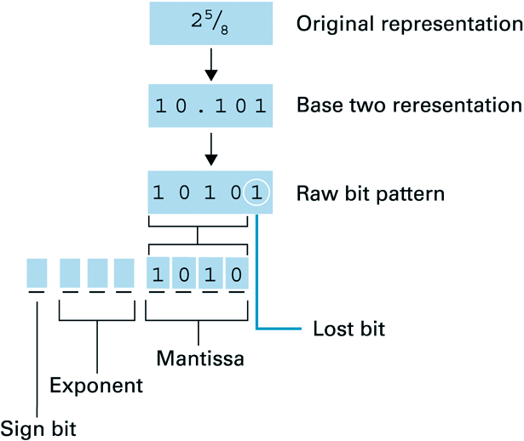
1.7 Truncation Errors: Coding the value 2 ^{5/8}

Slide 27
1.7 Truncation Errors (cont’d)
Significance of truncation errors reduced by using larger mantissa & exponent fields (32bits)
Problem of nonterminating expansion (e.g. 1/3)
worse in binary than in decimal system (e.g. 1/10)
Interesting:
2 1/2 + 1/8 + 1/8 = 2 1/2
1/8 + 1/8 + 2 1/2 = 2 3/4
When adding numbers, order may be important
rule: add smaller values first!

Slide 28
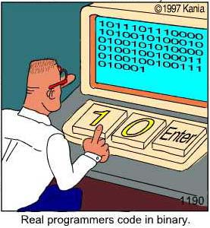

Slide 29
Chapter 1: Conclusions
Information stored as streams of bits
Bit streams stored in main memory or on mass storage devices - each with different degree of random access (and thus: speed)
Meaning of bit streams application dependent
Standardized representations exist for (a.o):
text, numeric values, images, sounds, …
For numeric values: overflow and truncation errors may make life difficult sometimes...

Slide 30
File Systems
FAT 16, FAT 32 and NTFS
File Size = 9KB
FAT 16 cluster size = 4KB
FAT 32 cluster size = 2KB
NTFS cluster size = 1KB
Services on hard disk
Fragmentation
Defragmentation
On Hard disk

Slide 31
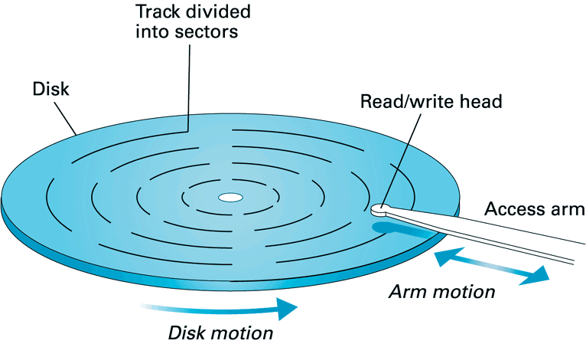

Slide 32
Retrieving Data From A Computer Prepared by Dr Syed Khaldoon Khurshid Powered by Brilliant Application

Slide 33
There are various devices that can store data on a computer. For example, hard disk drives (HDD), solid state drives (SSD), random access memory (RAM) modules, optical disks and drives, etc. We will go over key characteristics that are important from the software’s point of view.

Slide 34
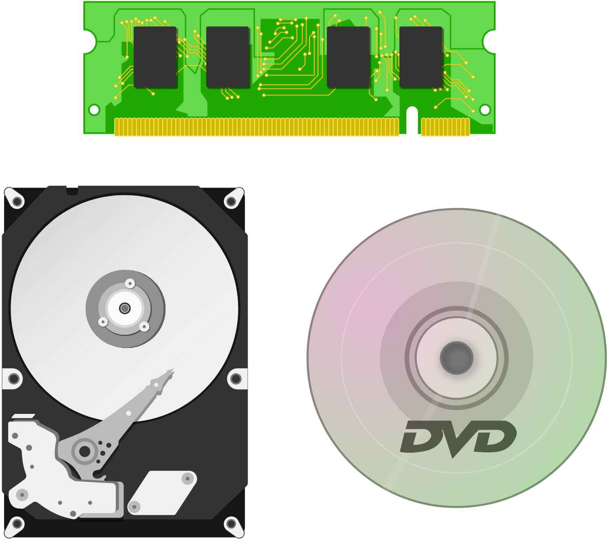

Slide 35

CDs, DVDs, and Blu-rays are optical disks that can hold (700MB−50 GB) of data, and are often used to distribute music, movies, and game software. ROM disks such as DVD-ROM are read-only and the stored data cannot be changed or overwritten. Rewritable disks such as DVD-RAM disks are read-write and the stored data can be changed or overwritten.

Slide 36
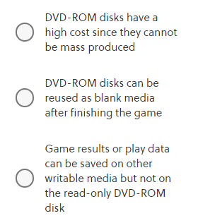
Assume that there is a video game software distributed on DVD-ROM disks. From the following, what is correct regarding the typical use of optical disks when distributing video game software?

Slide 37
Correct answer: Game results or play data can be saved on other writable media but not on the read-only DVD-ROM disk
The cost to produce optical disks is low considering the large amount of content that they can hold. Since DVD-ROM disks are read-only, the content stored on it cannot be changed. Game results or play data are often saved on other media such as memory cards, hard disk drives, etc.

Slide 38
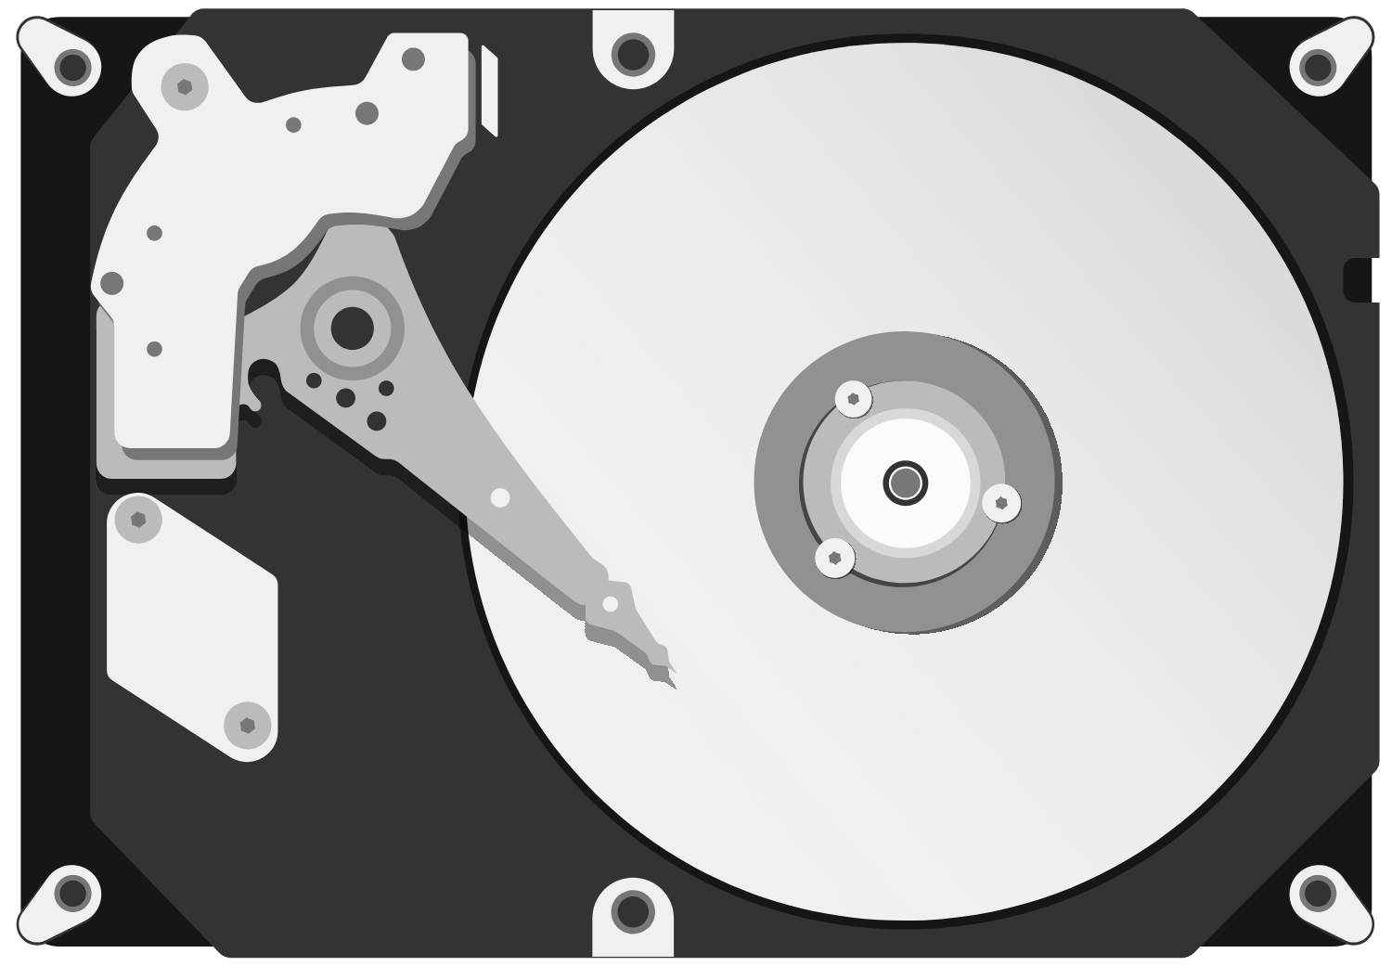
HDDs are spinning magnetic disks that can hold up to a few TB of data. They are often used as the main storage on computers to hold files and folders. The data access speed is fast for sequential accesses and becomes slower for random access. Sequential access is reading or writing from a continuous chunk of data. Random access is reading or writing from different places on the disk.

Slide 39
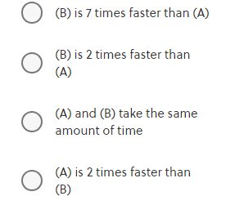
Given an HDD where the sequential access speed is 100 MB/s, which has an overhead of 10 ms when accessing a different place (random access overhead), and assuming that files are placed randomly within the drive and each file is stored continuously without any fragmentation, which of the following is correct regarding the speed of (A) and (B)?
(A) read 200 files, 50 KB each (10 MB total)
(B) read 20 files, 500 KB each (10 MB total)

Slide 40
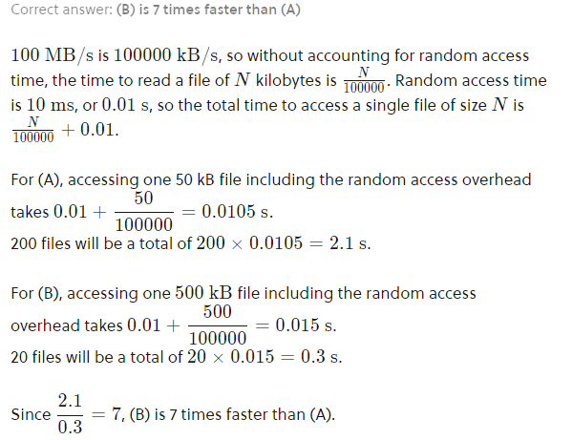

Slide 41
RAM is a semiconductor module that stores data within an integrated circuit that can hold up to a few GB of data. RAM is typically about 100 times faster than HDDs, and about 100 times more expensive for the same amount of data capacity. RAM does not have a significant speed decrease on random access. RAM is a volatile memory which can only hold data when power is provided, and will lose data when power is removed. Devices like HDDs and DVDs are non-volatile since they can hold data when power is removed.

Slide 42
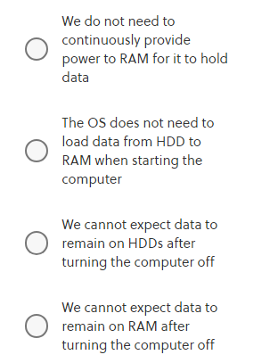
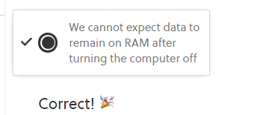
From the following, what is correct regarding volatility of devices?

Slide 43
Considering characteristics such as data capacity, access speed, volatility, read-only or read-write, the modern computer architecture uses HDDs or SSDs to store permanent data, and RAM for intermediate data. Programs will load files from the HDD or SSD to RAM, use RAM to calculate, and store necessary data in files on the HDD or SSD. RAM is accessed frequently from programs, and therefore it is called the “main memory”. In practical programming environments, when we use the word “memory”, we often mean RAM.

Slide 44
Given RAM and HDD where the access speed is 10 GB/s and 100 MB/s respectively, we want to read a 3MB file 25 times. Ignoring random access overhead and the cost of writing to RAM, which answer is correct regarding the speed of (A) and (B)?
(A) load the file from the HDD to RAM once, and read from RAM 25 times.
(B) read directly from the HDD 25 times.

Slide 45
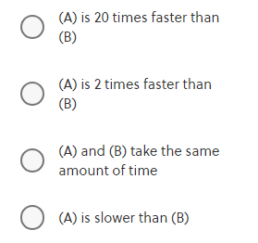

Slide 46
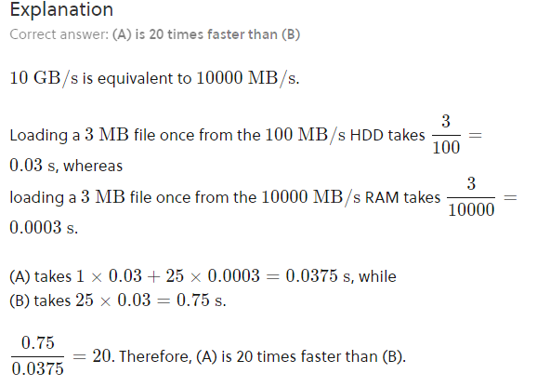

Slide 47
Any Questions?
Notes:
Reading
Richard Fayman -> Biography -> Interesting to read-> Physics lectures
Algorithms are eating our work-> Ted Talk.
Computer Limitations -> Travel’s sale man problem.
Contents are books, Grading -> not required
Less Text should be replaced by Images.
Slides makes students passive.

